Slide 1
Introduction to Psychology (PSY 101)
Monzia Mushtaq
Counselor
Counseling and Wellness Centre, BRAC University

Slide 2

Introducing Ourselves

Slide 3
Class Norms
Attendance, participation
Open-mindedness, respect for diverse perspectives
Encouragement to question and reflect
Maintain Confidentiality

Slide 4

Ask yourself….
Why are you taking this course?
What do you hope to learn?
How do you learn best? (visual, audio, group, solo?)

Slide 5
What is this course going to be like (Course Outline)?

Slide 6
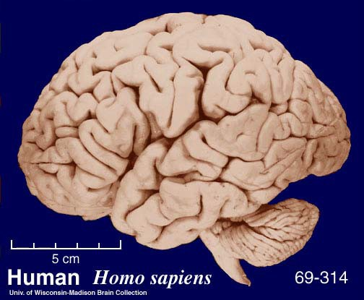


Introduction to Psychology
The Brain
Perception
Cognition
Emotion
Personality
Development
Psychopathology
Social and group interactions

Slide 7


Slide 8

Definition of Psychology
“The scientific study of behavior and mental processes.”
Break down:
Scientific → systematic methods
Behavior → observable actions
Mental processes → thoughts, feelings, motives

Slide 9
Think-Pair-Share
“Is psychology more of a science or an art? Why?”
Discuss in pairs, then share with class.

Slide 10
History of Psychology
Many ancient cultures throughout history have speculated on the nature of the mind, heart, soul, spirit, brain, etc. For instance, in Ancient Egypt, the Edwin Smith Papyrus contains an early description of the brain, and some speculations on its functions.
Psychology as a field of experimental study began in 1854 in Leipzig, Germany, when Gustav Fechner created the first theory of how judgments about sensory experiences are made and how to experiment on them. Fechner's theory, recognized today as Signal Detection Theory,
In 1879, Wilhelm Wundt founded the first psychological laboratory dedicated exclusively to psychological research in Leipzig, Germany. Wundt was also the first person to refer to himself as a psychologist.

Slide 11
History of Psychology
Soon after the development of experimental psychology, various kinds of applied psychology appeared. G. Stanley Hall brought scientific pedagogy to the United States from Germany in the early 1880s. John Dewey's educational theory of the 1890s was another example.
Behaviorism by John B. Watson, which was popularized by B. F. Skinner through operant conditioning. Behaviorism proposed emphasizing the study of overt behavior, due to the fact that it could be quantified and easily measured.
The final decades of the 20th century saw the rise of cognitive science, an interdisciplinary approach to studying the human mind. Cognitive science again considers the mind as a subject for investigation, using the tools of cognitive psychology, linguistics, computer science, philosophy, behaviorism, and neurobiology.

Slide 12
Major Perspectives in Psychology
Biological – Brain and genetics
Behavioral – Learning through environment
Cognitive – Mental processes
Psychoanalytic – Unconscious motives
Humanistic – Personal growth
Socio-cultural – Influence of society and culture
Evolutionary – Adaptation and survival

Slide 13
Let’s go through some interesting examples of perception, thinking..

Slide 14

ONE WAY NOT DO ENTER

Slide 15
PARIS IN THE
THE SPRING

Slide 16
Automaticity

Slide 17
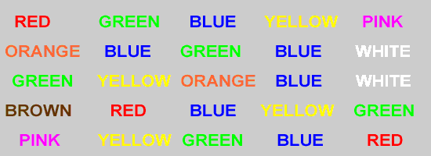
Word Set #1

Slide 18
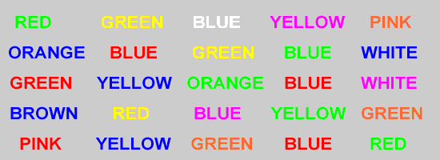
Word Set #2

Slide 19
Stroop Effect

Slide 20
Stroop Effect
It demonstrates the interference that automatic processing can have on task performance. It reveals how reading a word can interfere with naming the color of the word's font, showing the conflict between automatic and controlled processes.

Slide 21
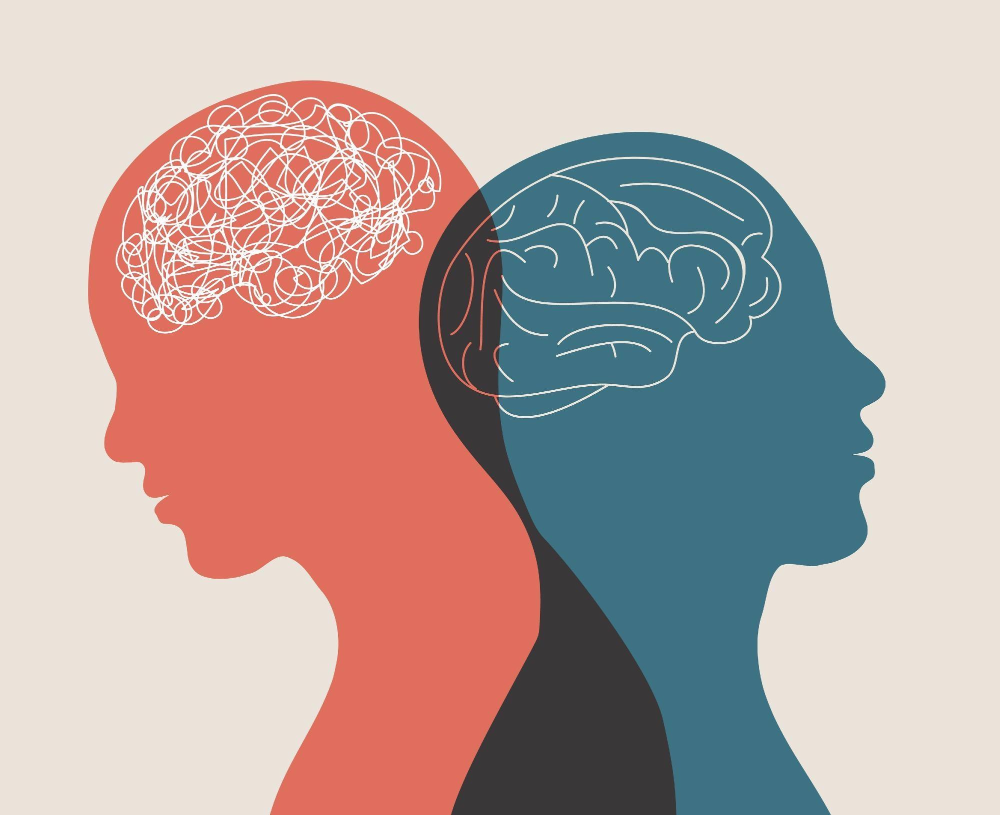
Mental Health

Slide 22
According to the World Health Organization (WHO):
"Mental health is a state of mental well-being that enables people to cope with the stresses of life, realize their abilities, learn well and work well, and contribute to their community." — World Health Organization, 2022
Key aspects of this definition:
Mental health is more than just the absence of mental disorders.
It involves positive functioning, such as emotional, psychological, and social well-being.
It varies across time and is influenced by individual, social, and structural factors.

Slide 23





Objectives: The Scientific Study of human nature, mind, and behavior
How our minds make our worlds
What we see
What we hear
What we smell
What we taste
How we feel
How we think
What we remember
What we know
How we act

Slide 24
Psychology’s Subfields
Subfield | Description
Experimental Psychology | The process of sensing, perceiving, learning and thinking about the world.
Developmental Psychology | Examines how people grow and change from the moment of conception through death.
Counseling Psychology | Helping process that enable people to develop self understanding and make positive changes in their lives.
Clinical Psychology | Deals with the study, diagnosis, and treatment of psychological disorder.
Educational Psychology | Concerned with teaching and learning process.
Environmental Psychology | Considers the relationships between people and their physical environment.

Slide 25
Psychology’s Subfields
Subfield | Description
Social Psychology | Study of how people’s thoughts, feelings, and actions are affected by others.
Health Psychology | Explores the relationship between psychological factors and physical ailments or diseases.
Cognitive Psychology | Focus on the study of higher mental process.
School Psychology | Devoted to counseling children in elementary and secondary schools who have academic or emotional problems.
Industrial/Organizational Psychology | Concerned with the psychology of workplace.
Sport Psychology | Applies psychology to athletic activity and exercise.

Slide 26
Contacting me!
Email: monzia@bracu.ac.bd
Contact: +8801784895561

Slide 27
Questions?

